Slide 1

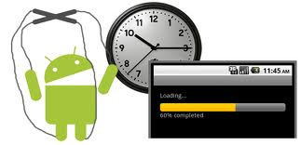
Android Threads
Dimitar Ivanov
Mobile Applications with Android
Telerik Software Academy
http://academy.telerik.com

Slide 2
Today’s Topics
Threading Overview
Android’s UI Thread
The AsyncTask Class
The Handler Class

Slide 3
What is a Thread ?
Conceptual View
Parallel computation running in a process
Implementation View
A program counter and a stack
With heap and static areas that are shared with other threads.

Slide 4
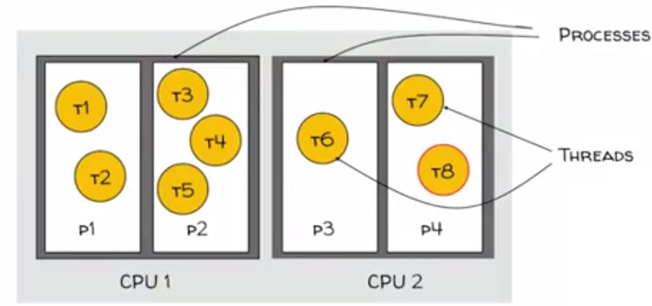
What is a Thread ?

Slide 5
Java Threads
Represented by an object of type Java.Lang.Thread.
Implements the runnable interface
void run()
Some thread methods
void start()
Starts the Thread
void sleep(long time)
Sleeps for the given period

Slide 6
Java Threads
Void wait()
Current thread waits until another thread invokes notify() on this object.
Void notify()
Wakes up a single thread that is waiting on this object.

Slide 7
Basic Thread Use Case
Instantiate a Thread object
Invoke the Thread’s start() method
Thread’s run() method get called
Thread terminates when run() returns

Slide 8
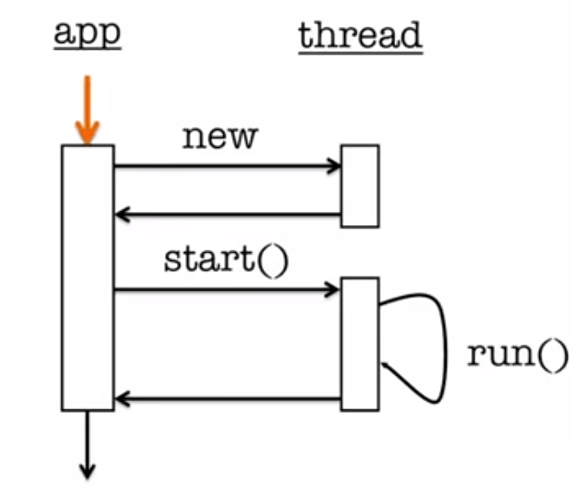
Basic Thread Use Case

Slide 9
ThreadingNoThreading Demo
Application displays two buttons
LoadIcon
Load a bitmap from a resource file & display
Show loaded bitmap
Other Button
Display some Toast text

Slide 10
AsyncTask
Provides a structured way to manage work involving background & UI Threads
Background Thread
Perform work
Indicate progress
UI Thread
Does setup
Publishes intermediate progress
User results

Slide 11
AsyncTask
Generic Class
Class AsyncTask<Params,Progress,Result> {
…
}
Generic Type Parameters
Params – Type used in background work

Slide 12
AsyncTask
void onPreExecuted()
Runs in UI Thread before doInBackground()
Result
doInBackground(Params…params)
Performs work in background Thread
May call
void publishProgress(Progress… values)

Slide 13
AsyncTask
void onProgressUpdate(Progress… values)
Invoked in response to publishProgress()
void onPostExecute(Result result)
Runs after doInBackground()

Slide 14
Async Demo

Slide 15
Handler
Each handler is associated with a Thread
One thread can hand off work to another Thread by sending
Messages & Posting Runnables to a handler associated with other Thread.
Runnable
Contains an instance of the Runnable interface
Sender implements response
Message
Can contain a message code, an object & integer arguments

Slide 16
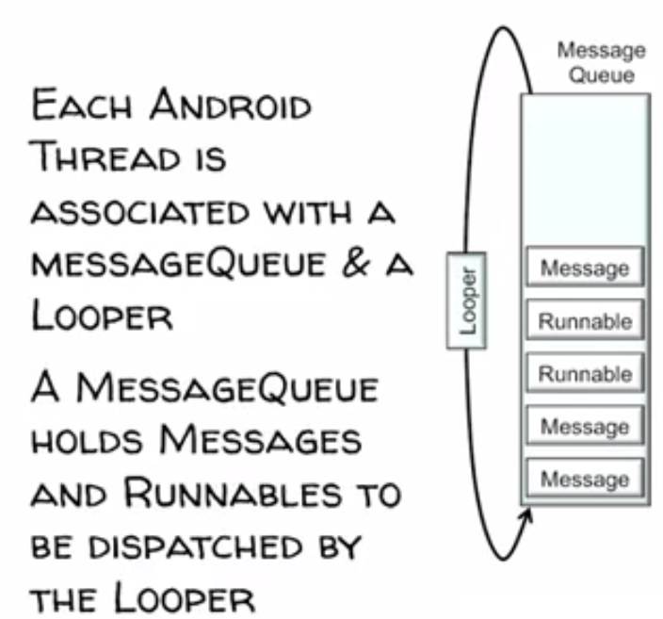
Handler Architecture

Slide 17
Runnables & Handlers
boolean post(Runnable r)
Add Runnable to the MessageQueue
Boolean postAtTime(Runnable r,long uptimeMillis)
Add Runnable to the MessageQueue.Run at a specific time(based on SysteClock.upTimeMillis())
Boolean postDelayed(Runnable r,long delayMillis)
Add Runnable to the message queue.Run after the specific amount of time elapsed.

Slide 18
Messages & Handlers
Create Message & set Message content
Handler.obtainMessage()
Message.obtain()
Message parameters include
Int arg1,arg2, what
Object obj
Bundle data
Many variants.See documentation

Slide 19
Messages & Handlers
sendMessage()
Queue Message now
sendMessageAtFrontOfQueue()
Insert Message now at front of queue
sendMessageAtTime()
Queue message at the stated time

Slide 20
Handler Demo

Slide 21
Android Threads
http://academy.telerik.com

